Slide 1
Rapid Reservation
Restaurant Reservation App
Group 18

Slide 2
Group 18 Team
Anthony Epps Dakotah Campbell Jason Lee Kevin Hernandez Gaspar Mangala Dadallage Prince Varghese

Slide 3
Project Overview
The goal of this project is to develop a web app quickly, efficiently and to meet the goals of the end user. The web app will allow customers to log in, see a model of the table and all available seating, and make a reservation. They then will be allowed to look at the menu and place an initial order, so that when they arrive, the food will be ready to be brought out, reducing wait times to essentially zero!

Slide 4
Team Collaboration and Project Management
For project collaboration, we will be using:
Microsoft Teams
GitHub.
Microsoft Teams will be used for team communication. We will use GitHub to host all repositories and documents related to the project. For diagrams, we will use LucidChart, Mermaid, Excalidraw and Google Docs.

Slide 5
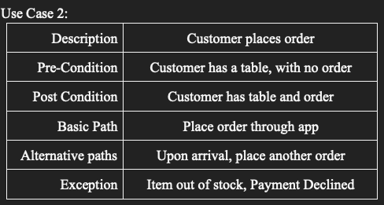
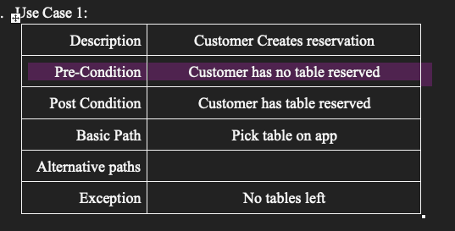
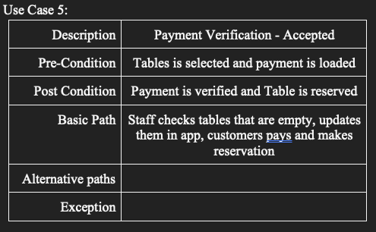
Project Features, User Stories, or Use Cases
Enhancing the Customer Experience
User Login
Table Reservation
Menu Viewing

Slide 6
Requirement Specifications
Business Requirements:
Allow customers to put in their order remotely
Restaurant workers need to be able to access orders before customers arrive
Customers can pay for their meals through the application
Allow customers and staff be able to communicate through the application
Enable customers to have food paid for and ordered before they arrive at restaurant

Slide 7
Requirement Specifications
User Requirements:
Require ordering food and make payments online.
Require including add on items to the main order.
Screen to see whether the order is started preparation, in progress, or ready to pick up.
The payment receipt requires a reference number to track the order.
Require a user account to collect points for free meals, review previous orders, and write reviews.

Slide 8
Requirement Specifications
Functional Requirements:
Must enable customers to make reservations online and place food orders in advance, allowing customization of orders and specifying dining times.
Provide a user-friendly interface with detailed menu descriptions and images, allowing customers to easily customize their orders based on dietary preferences and portion sizes.
Must be integrated with the restaurant's kitchen operations to provide real-time order updates, ensuring that food is prepared and ready for pickup at the specified reservation time.
Send immediate order confirmations and periodic status updates to customers via email, SMS, or the app, keeping them informed about the status of their orders.
Automatically assign tables to pre-ordering customers based on their reservation times and party size, as well as notify customers when their table is ready for seating.

Slide 9
Requirement Specifications
Non-Functional Requirements:
Processing the reservations must be completed as fast as possible with little error to avoid accidental duplicate reservations
Order Screen must be easy to understand on how to add or remove items
When food is added to the order, it should be immediately displayed, and total price should be updated dynamically
Menu should be in an easy to view manner with all necessary information visible

Slide 10
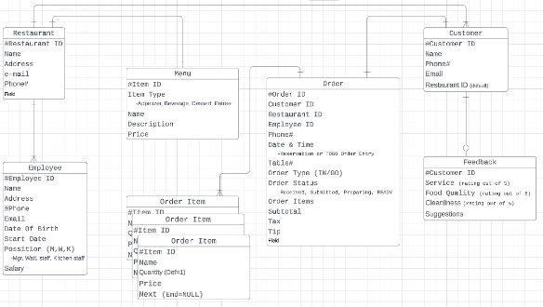
High-Level Design
Architecture, Database, and Data Flow
For the fine dining restaurant web application, a multi-tier architecture would be suitable to meet the project objectives and requirements. This architecture divides the application into distinct layers, each responsible for a specific set of functionalities.
The database has seven entities: Restaurant, Employee, Customer, Menu, Feedback, Order Item & Order. Many relationships are one to one or one to many relationships, and there is one number of one to one or one to zero relationship between the Customer and the Feedback.
All the reservations, dine in & TOGO orders are placed in ‘Order’ entity. Moreover, the customer can see whether the status of the order is received, submitted, prepared or ready.
Client enters reservation details, which flows to the App.
App provides reservation confirmation back to the Client.
Client enters order details, which flows to the App.
App provides order confirmation back to Client.
App notifies the Kitchen of the new food order.
The Kitchen notifies the Waitstaff when the food is ready.

Slide 11
Security Measures and Hardware
Security (Required)
Login Management: In today's world, security of personal data is at the forefront of everyone's minds. I feel like for this application, we would want to implement something like NextAuth.js or another authentication framework to handle authentication and data management so we do not have to worry about it. This will let us focus on building just the app and not the app and then a safe, secure authentication system.
Payment Management: Similar to the login system, we do not want to “own” responsibility of storing, securing and accessing customer financial data. This can be offloaded to a service like Stripe.
Hardware (Required)
Computer (Restaurant Use)
Monitor (Restaurant Use)
Tablet (Restaurant and End User)
Mobile Phone (End User)
Server in Cloud (App)

Slide 12
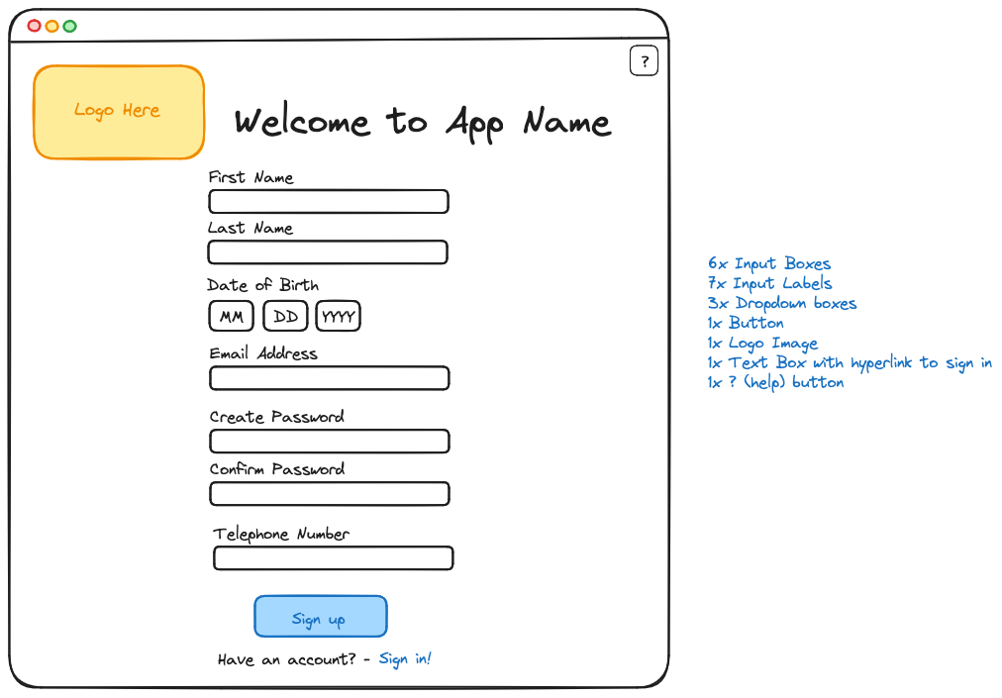
User Interface

Slide 13
Reports and Internal/External Interfaces
Generating Reports and Collaborating with External Systems
User Reports: The app will be able to create user reports for the staff at the restaurant. The reports will offer information such as total number of app reservations, the most book tables, the most ordered food, the day of most reservations per week.
Customer Reports: The app will offer a report to the customers. The reports will offer information such as total time saved by using reservation service, and receipt history.

Slide 14
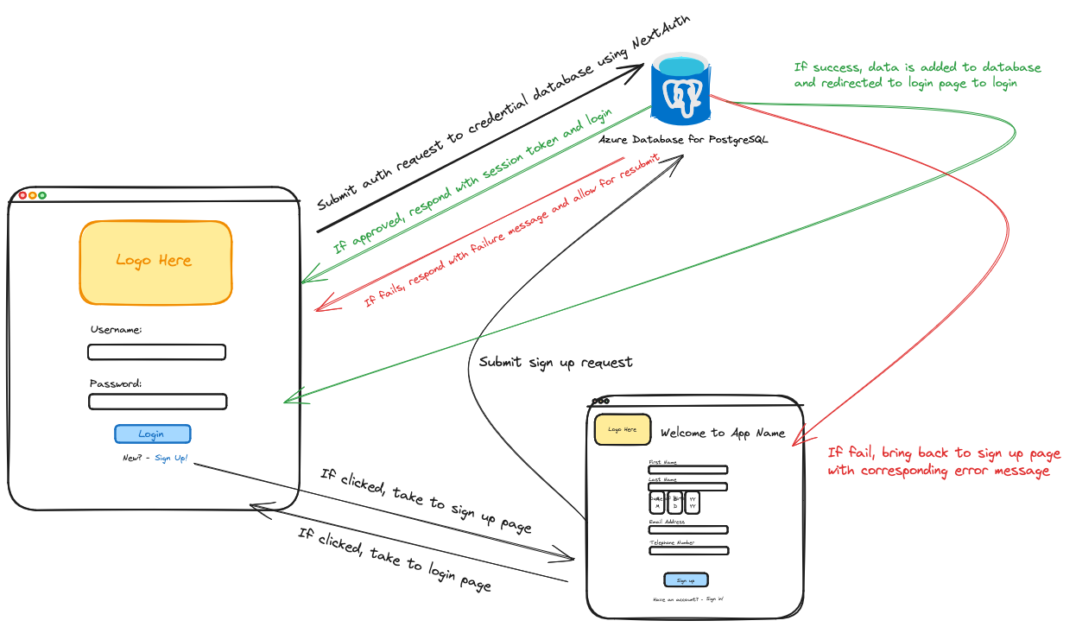
Internal Interfaces

Slide 15
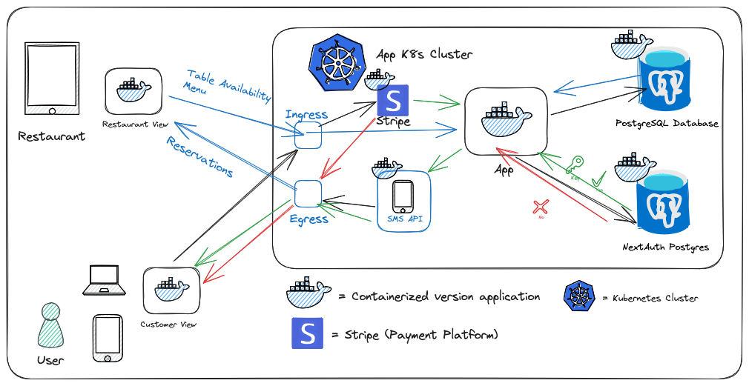
External Interfaces

Slide 16
Configuration and Training
Configuration Data: The following data is configurable:
● Reservation Expiration Time
● Number of Tables
● Number of Seats per table
● Available Menu
Training Data: A User's Guide will be provided to customers demonstrating the application functions. Each page of the app will also feature a help button, denoted by a [ ? ] button.

Slide 17
Conclusion and Questions
Thank you for your time!
Questions?

